Slide 1
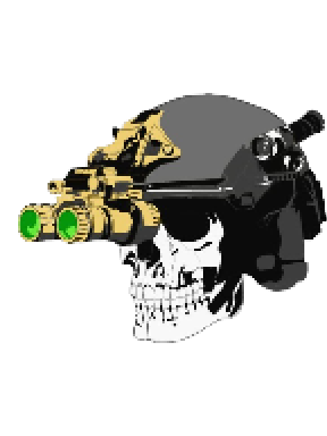
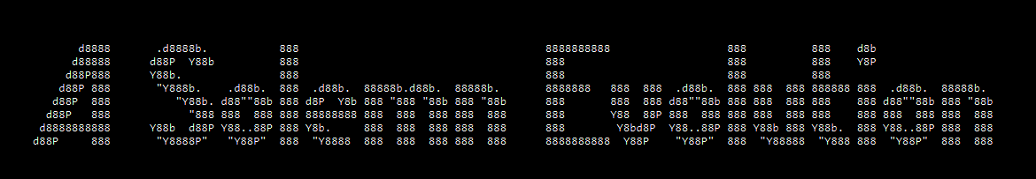
Written, Developed, and Published by Adam Thiemann

Slide 2
Problem Statement
My project aims to assist society in helping combat veterans with “feeling connected,” by releasing my own memoirs with the intent of helping society to better understand combat, veterans to better understand their own experiences, and increasing the ability for Christians to deal with these relationships on an intimate level.

Slide 3
Features to be Tested
The following features were to be tested, using a survey, to show how well the program solves the problem statement:
Playability
Emotional Response
Literary Quality

Slide 4
Survey: Bias and Limitations
The survey gauged users on how well the program solved the problem statement, without giving users the problem statement.
Most survey takers were likely my friends and family, though some were from random players.
Initially, I did not make users input their email. Thinking it would serve better to legitimize the results, I added the email requirement. After hitting 18 results, I removed the email requirement again because it was brought to my attention that random individuals would likely not take the survey if they had to input their email. After that, many of the results were from random players.
Survey results are viewable here.

Slide 5
Survey: Layout
The survey gauged solution of the problem statement and tested the three features through five questions. The questions were as follows:
1. What emotions did you experience while playing the game? (Multiple Choice)
2. What Biblical themes did you notice? (Mandatory, short answer)
3. Do you feel like your understanding and/or awareness of the endeavors of combat increased? (Yes/No)
4. If your understanding/awareness increased, how so? (Optional, short answer)
5. What other comments do you have? (Optional, short answer)
Survey results are viewable here.

Slide 6
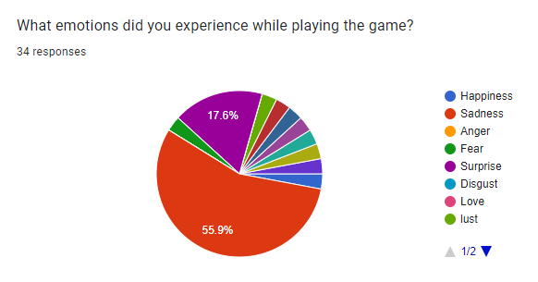
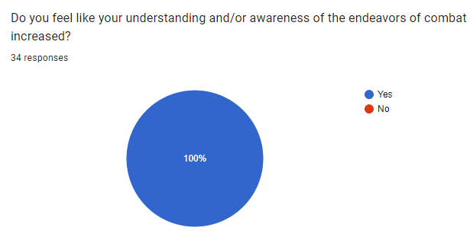
Survey: Summary
Individuals overwhelmingly experienced a sense of sadness and surprise.
All individuals felt as if their understanding or awareness of the endeavors of combat increased.
Survey results are viewable here.
Notes:
Surprise indicates that individuals did in fact learn something that can help them relate to veterans’ experiences. Sadness relates to the literary quality that so many experienced similar emotions.
An 80% positive response is the threshold for passing this portion of the test.

Slide 7
Survey: Summary (Cont’d)
Major Biblical Themes
Category | Service and Sacrifice | God's Plan and Will | Faith and Love | Forgiveness and Redemption
Count | 6 | 6 | 5 | 5
Survey results are viewable here.
Notes:
These results indicate major biblical themes were recognizable from the text. This shows that the game has, at bare minimum, pointed individuals to recognize the biblical themes that may be useful to understand other combat veterans. These results were garnered from open-ended short answer, further pointing to the ability of players to gauge the major themes because of literary quality.

Slide 8
Survey: Summary (Cont’d)
If your understanding/awareness [of combat] increased, how so?
The major similarities gathered from the open-ended answers were that individuals experienced a deepened understanding and empathy for the experiences conveyed in the game. The responses highlighted the impact of witnessing the realities of war, the need for rapid decision making, and the mental and physical toll it takes on those who experience combat.
Survey results are viewable here.
Notes:
This is not necessarily a response that would indicate an understanding which would make one capable of connecting with combat veterans on a deeper level. Empathy is certainly not something most combat veterans wish to receive from others, but perhaps the knowledge of the more intimate experience will cause one to take pause and make one reflect about whether they should feel empathy, or whether they should feel pride at what that individual may have accomplished.
One user wrote:
"The game is very genuine, realistic, no sugar-coating. A rare thing in game industry these days. The game doesn't seem to have been designed to please the player and boost their self-esteem like other games out there. It was made to communicate a strong message and immerse the person playing into the emotions and thinking process of a young soldier following God's calling through military service. Games and movies often dehumanize war, making people merely statistics. This game drew attention to 1. the importance of remembering those whose lives war has claimed; 2. the fact that soldiers are not machines - they are human beings who bear extremely heavy emotional and physical burdens so that the rest of us could be safe.“

Slide 9
Survey: Conclusion
Gauging Emotional Response and Literary Quality
These features were gauged through the survey and should be considered successful due to the overwhelmingly positive response. The emotional responses felt by individuals were largely similar, which conveys the ability of the writing to deliver a similar experience to largely different individuals. Additionally, in a question which related nothing to either literary quality or emotional response, users were given the option to respond to an open-ended question, “What other comments do you have about the story or game?” Of the 30 who responded, 10 mentioned the quality of the writing positively.
Gauging Playability
Of the 34 people who took the survey, 2 experienced game ending bugs. The rest of the players typically experienced issues with text formatting or rendering, with a total of 11 comments about such issues. 10 people reported no bugs at all, and 5 did not answer the question about bugs. Though there are certainly bugs and formatting issues, the game does play through and convey the story to the end. The game should be considered playable, and the test considered a positive result.
Survey results are viewable here.
Notes:
The most indicative result that the emotional response and literary quality features tested positively was, “The game brought up emotions and thoughts that I would not have created "on my own" or without the game to bring them to light” from user jakemenchinger95@gmail.com.
Unique take on interactive storytelling. Gamifying the user's decisions via a score system created a more thought-provoking/reflective experience.
The text was fairly engaging.
Solid overall storytelling & connections to Biblical ideas.
I felt like I could feel the emotions Adam was experiencing.
The game brought up emotions and thoughts that I would not have created "on my own" or without the game to bring them to light.
"The game is very genuine, realistic, no sugar-coating. A rare thing in game industry these days..."
It was deep and actually made me understand this.
a poignant story that is incredibly grounded.
The true emotions and feelings make this story or game so realistic.
Well written and deep questions were brought up. This opened my eyes to what our military must endure in times of war. I am so thankful to them!

Slide 10
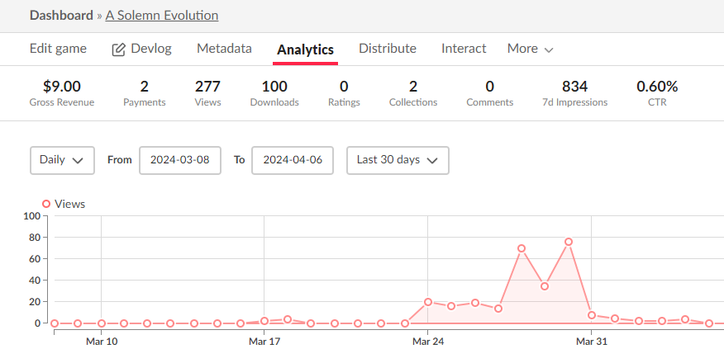
Impact
Through publishing on itch.io, A Solemn Evolution was viewed by roughly 300 people and downloaded 100 times.
Notes:
These results show that the general impact of the game was somewhat limited. There were three factors which contributed to limiting the success of the game: Deployment involves extracting a .zip and running an unlicensed .exe file. Many potential players would absolutely not bypass antivirus warnings to do this. Additionally, the second most impactful factor was the release of a game which did have bugs. Some of these bugs were fixed shortly after release, but by then people understood that sometimes the game may not be winnable. This certainly reduced player engagement upon first playthrough. Though the bugs are now fixed, when the majority of downloads happened I was not aware of them. It would have been better to have a legitimate testing suite or dedicated player testing prior to the actual release. Obviously, this is my senior project and I am working with fairly limited time and capital resources, but these lessons can be applied to future projects. Lastly, the game was not marketed whatsoever. There is no page where players can go to learn more, there was no social media campaign, free or paid, and there were no advertisements whatsoever except who I reached out personally once the game was released.

Slide 11
Specific Test Cases: Failures
4/20 Test Cases did not meet the criteria specified in the Atomic Requirements document.
The Plot
The Graphics
Text Input
Game Functions
Test Case results are viewable here.

Slide 12
The Plot
The Graphics
The Plot did not contain 3 separate chapters. Though 3 were written, they were not implemented in the visual novel.
I believed graphic representations would have broken immersion rather than added to the story. I chose not to add any until the end.
Text Input
Game Functions
I opted to take out the traditional text input of text-based RPG’s because the focus of the game was the plot, not the game elements.
Though the game piece of the novel could have been better refined by seeding sinusoidal or logarithmic distributions, the playability of the novel was more important and the feature was triaged.
Test Case results are viewable here.

Slide 13
Problem Statement (Re Iterated)
My project aims to assist society in helping combat veterans with “feeling connected,” by releasing my own memoirs with the intent of helping society to better understand combat, veterans to better understand their own experiences, and increasing the ability for Christians to deal with these relationships on an intimate level.
Notes:
In conclusion, A Solemn Evolution was an overwhelming success based on the problem statement and atomic requirements set forth in the planning documentation. 80% of the original requirements set forth in the Atomic Requirements test case criterion tested successfully. In addition, the problem statement was shown to be addressed through the survey results which tested 3 major features of the program: its’ playability, the literary quality, and the emotional response. By measuring these features through the survey, I was able to gauge whether society better understood combat veterans, guide veterans to better understand their own experiences through the use of biblical themes, and whether Christians could guage the biblical principles which impact servicemembers who have experienced combat.
I determined the playability, literary quality, and emotional response to be the factors most important in supporting my assertion that the program was an overwhelming success. Each of these factors tested successfully, showing that 65% of players were able to determine meaningful Biblical themes which can be used to support individuals returning from war; 100% of players gained knowledge about the hardships experienced in combat to better relate to combat veterans; 75% of players experienced the emotions of sadness or surprise, emotions which are certainly relatable for combat veterans; at least 33% of players were drawn into the writing, without being prompted for that input; and that the game is playable because only 2 individuals experienced game ending bugs which were later fixed. Additionally, the game was viewed by over 300 people, and downloaded by 100, showing that despite this game’s faults, there is an interest in assisting veterans’ mental health issues and learning about the experiences of combat.

